Slide 1
COMS E6998: Microservices and Cloud Applications Lecture 3: Microservices, Session State, Composition,Promises, Multitenancy
Dr. Donald F. Ferguson
dff9@columbia.edu

Slide 2
1st Project Reminder

Slide 3
1st Project – Part 1
Implement two distinct microservices
Person
Address
Tasks
Use Swagger Editor to define and document REST APIs.
Implement an Elastic Beanstalk application (microservice) for each resource that implements the relevant REST API.
Each microservice should support
GET and POST on resource, e.g. /Person
GET, PUT, DELETE on resource/id, e.g. /Person/dff9
Simple query, e.g. /Person?lastName=Ferguson
Pagination
Relationship paths: /Person/dff9/address and /Addresses/someID/persons
HATEOAS links where appropriate.
Simple HTML/Angular demo UI.
Due: 11:59 PM on 26-Sep-2017

Slide 4
Microservices

Slide 5
1st Project – Part 1
Implement two distinct microservices
Person
Address
Tasks
Use Swagger Editor to define and document REST APIs.
Implement an Elastic Beanstalk application (microservice) for each resource that implements the relevant REST API.
Each microservice should support
GET and POST on resource, e.g. /Person
GET, PUT, DELETE on resource/id, e.g. /Person/dff9
Simple query, e.g. /Person?lastName=Ferguson
Pagination
Relationship paths: /Person/dff9/address and /Addresses/someID/persons
HATEOAS links where appropriate.
Simple HTML/Angular demo UI.
Due: 11:59 PM on 26-Sep-2017

Slide 6
Introduction to Promises

Slide 7
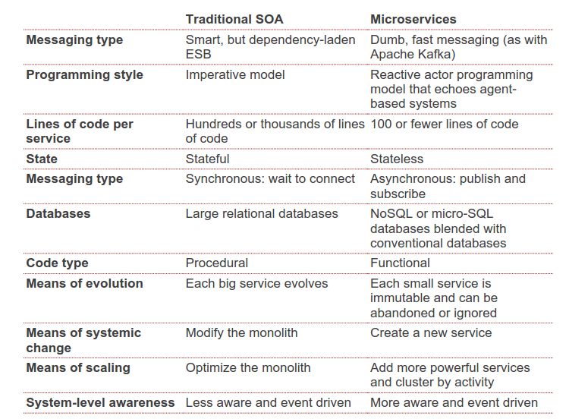
SOA vs Microservices
http://www.pwc.com/us/en/technology-forecast/2014/cloud-computing/features/microservices.jhtml
Asynchronous requires a style of programming that
Is different from most applications students have written.
Can be counter-intuitive.
I have seen students struggle with the transition.
Will provide a simple overview to start, and expand through projects.

Slide 8
Promise Basics

Slide 9
Composing Promises (https://www.guru99.com/node-js-promise-generator-event.html)

Slide 10
Cloud/Microservice Spanning Promises
This would “seem” easy, but …
Sometimes the language runtime “goes away.”
Multiple servers.
etc.

Slide 11
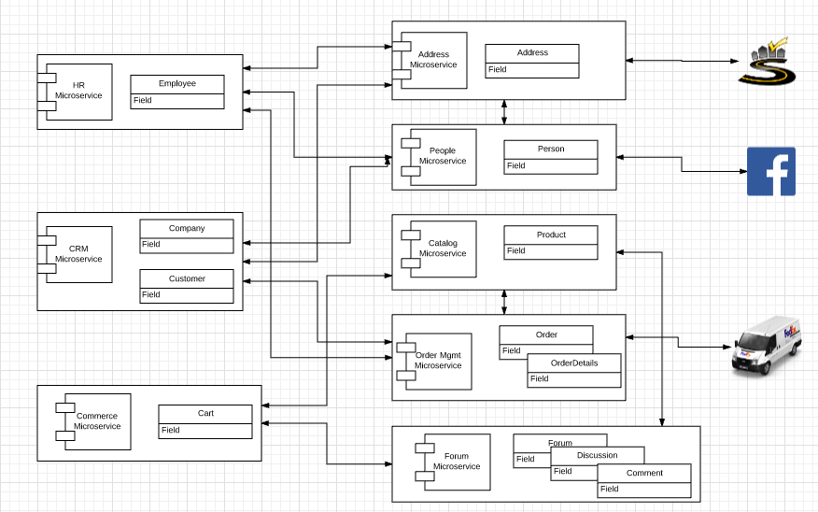
Project Microservice Model
Create Employee
C

Slide 12
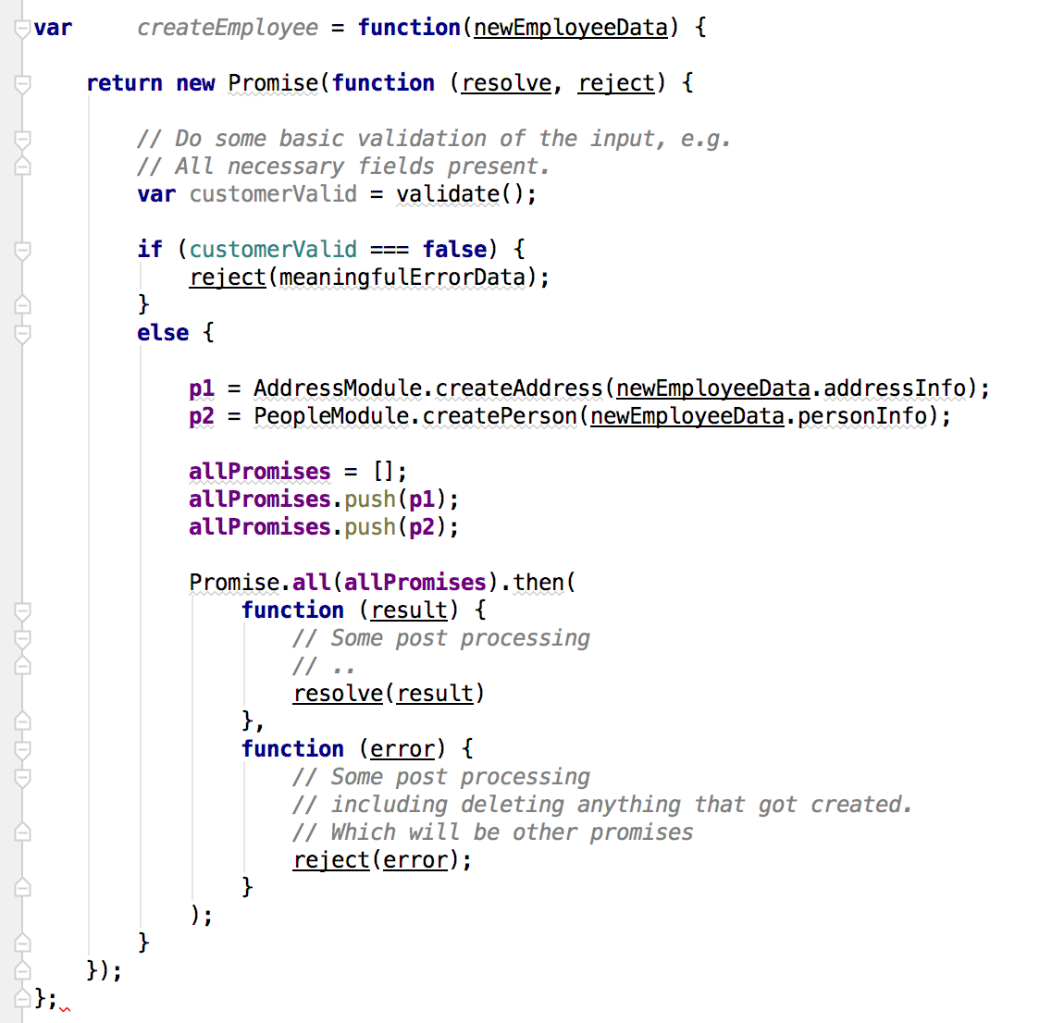
Some Pseudo-Code
Return a Promise
Validate and possibly reject.
Implementation requires calling two microservices.
Can only process when both Promises resolve.
Success
May need to call other asynchronous functions to recover.

Slide 13
Some Pseudo-Code
Implementing microservice code is less about traditional flow of control constructs, e.g.
Loops
Function calls
If {} then {}
And more about
Returning a Promise
Composed of sub-Promises
Return a Promise
Validate and possibly reject.
Implementation requires calling two microservices.
Can only process when both Promises resolve.
Success
May need to call other asynchronous functions to recover.

Slide 14
Beyond Simple Promises (http://bluebirdjs.com/docs/api-reference.html)

Slide 15
Some Pseudo-Code
There are a couple of problems with this section.
Promise.all() is parallel.
But, createAddress returns the URL of the created resource, which is needed to create the customer.
So, the code must use
Promise.each() and
Figure out how to pass data from the resolved 1st promise to the second function.
Return a Promise
Validate and possibly reject.
Implementation requires calling two microservices.
Can only process when both Promises resolve.
Success
May need to call other asynchronous functions to recover.

Slide 16
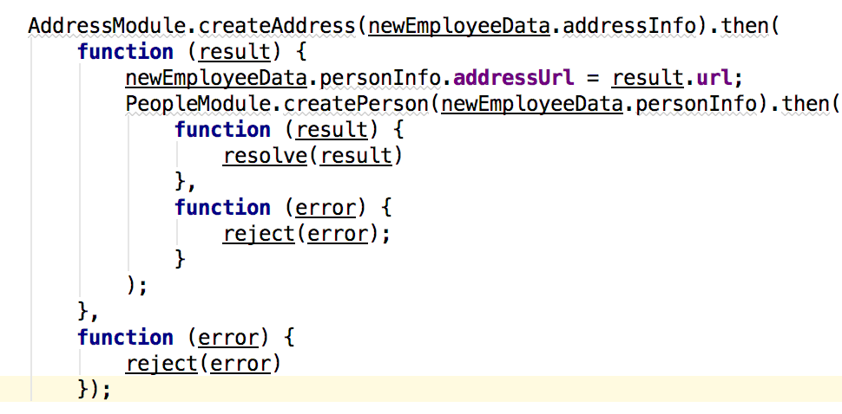
Better Pseudo-Code?
This code
Is relatively clear but
Would turn into nesting spaghetti for more than two related objects.
This is an example of the orchestrator pattern, which can be done with
Spaghetti code
“Algebraically” in code with use of any(), map(), each(), series(), etc.
Or done with an orchestration services like workflow or step functions.

Slide 17
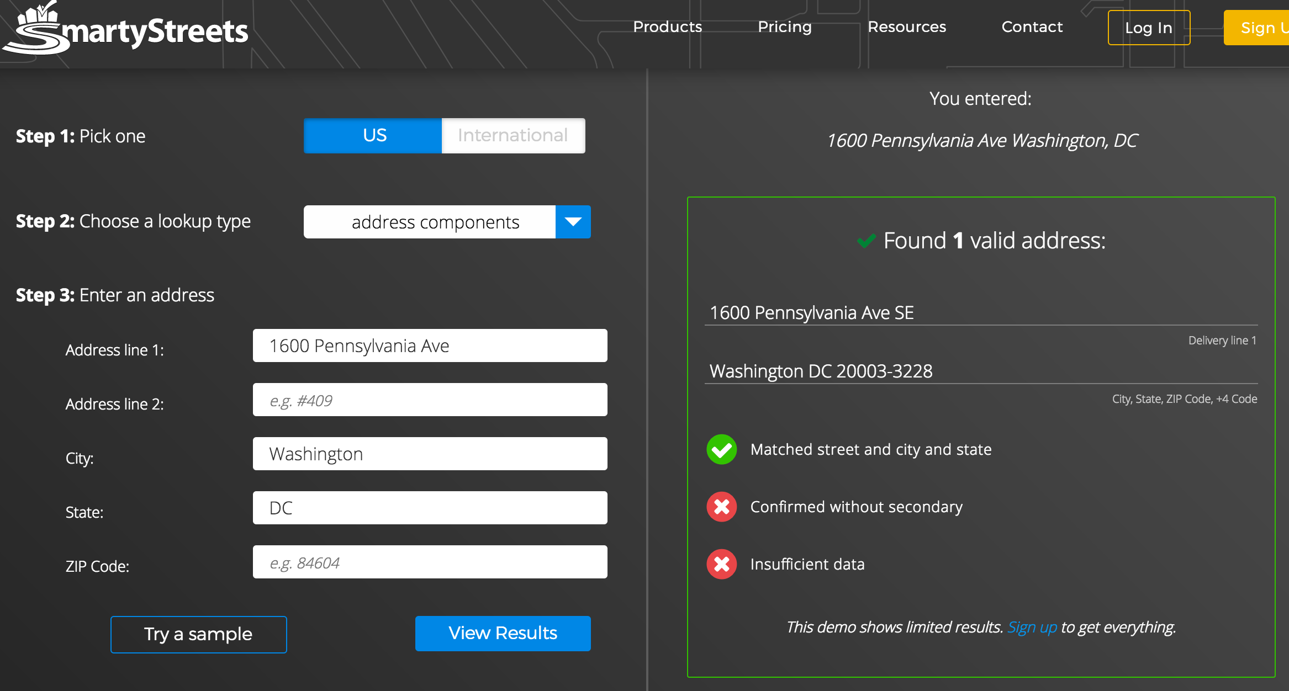
Smarty Streets (Demo)

Slide 18
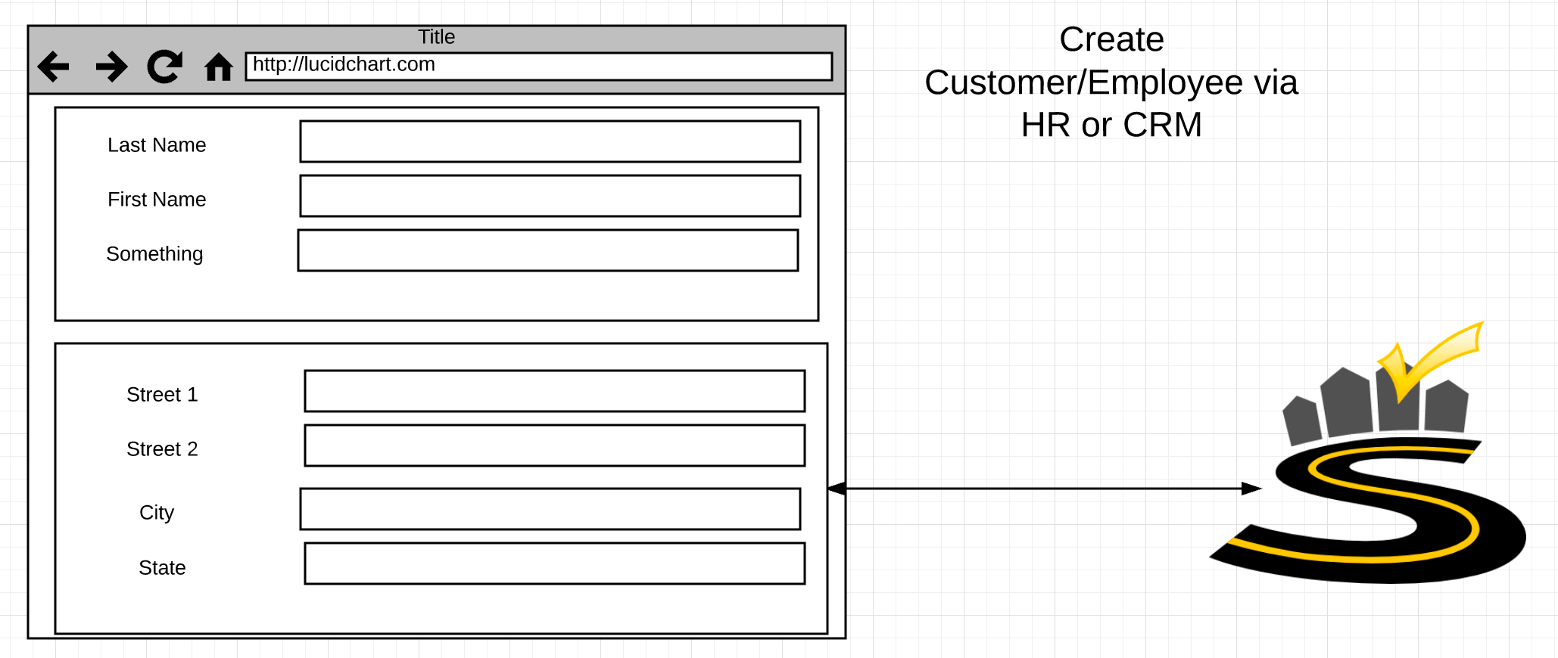
UI

Slide 19
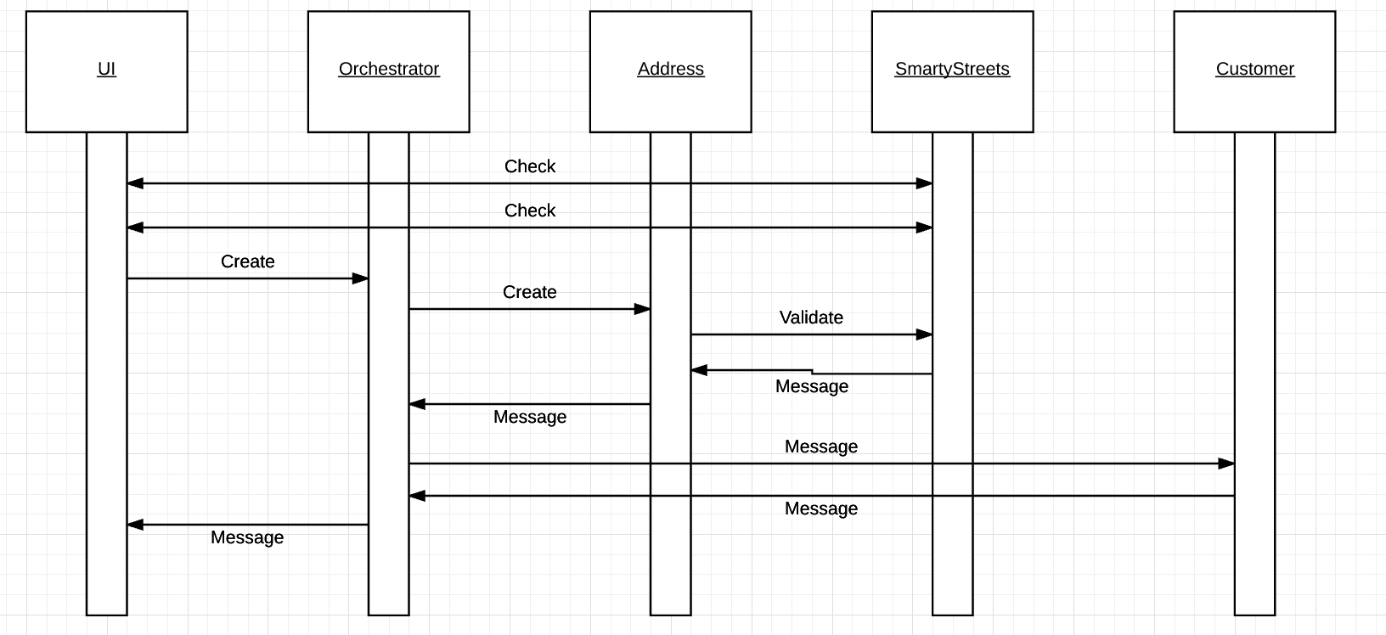
Successful Execution

Slide 20
Message Exchange Patterns

Slide 21
REST Messages and Verbs
Simple examples just showing success
There are, of course, many other return codes and patterns.

Slide 22
Message Patterns
At the REST/HTTP level, each of the individual arrows may be
HTTP Verb.
HTTP Response.
But from the application level, it is more complex.
PUT or POST response could mean
I created/updated the resource, or
I am working on creating/updating, and will notify you.
GET response could mean
Here is the data, or
In the future look here for the data.
A one-way input
Could be creating something (e.g. webhook)
That will generate many one-ways back.

Slide 23
Synchronous/ Asynchronous
1)
“Synchronous”
Request is HTTP Verb
Response is application data in the HTTP response.
“Asynchronous”
Request 1 is HTTP Verb.
Input is data and “callback URL.”
HTTP Response is “Accepted.”
Response is HTTP Verb
To callback URL with app rsp data.
HTTP response is “OK.”
2)

Slide 24
REST Messages and Verbs
Calling an API via REST
Is logically similar to calling a local function in your code.
But,
The implementation is somewhere else.
Takes several orders of magnitude more time to complete.
What does the calling runtime environment do? Wait? What about all the other things the runtime is doing?
Some runtimes, like Java model the calls as synchronous on separate threads.
Others (browsers, Node) are inherently, single threaded and the call inevitably goes asynchronous.

Slide 25
Which Patterns for Which Interactions?

Slide 26
Success Response Codes
202 means
Your request went asynch.
The HTTP header Link is where to poll for rsp.
We will cover later.
Operation | HTTP Request | HTTP Response Codes Supported
READ | GET | 200 - OK with message body 204 - OK no message body 206 - OK with partial message body
CREATE | POST | 201 - Resource created (Operation Complete) 202 - Resource accepted (Operation Pending)
UPDATE | PUT | 202 - Accepted (Operation Pending) 204 - Success (Operation Complete)
DELETE | DELETE | 202 - Accepted (Operation Pending) 204 - Success (Operation Complete)
Examples of Link Headers in HTTP response:
Link: <http://api/jobs/j1>;rel=monitor;title="update profile"
Link: <http://api/reports/r1>;rel=summary;title=”access report”

Slide 27
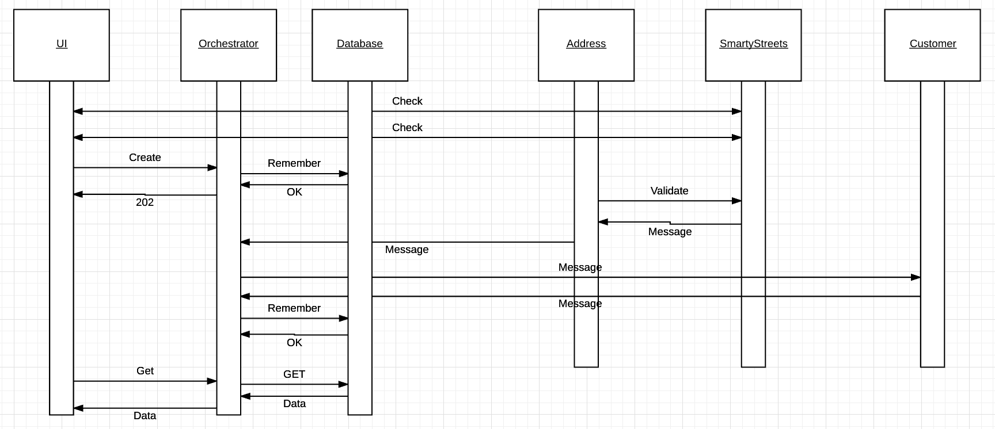
One Possibility

Slide 28
Enable User Interface

Slide 29
1st Project – Part 1
Implement two distinct microservices
Person
Address
Tasks
Use Swagger Editor to define and document REST APIs.
Implement an Elastic Beanstalk application (microservice) for each resource that implements the relevant REST API.
Each microservice should support
GET and POST on resource, e.g. /Person
GET, PUT, DELETE on resource/id, e.g. /Person/dff9
Simple query, e.g. /Person?lastName=Ferguson
Pagination
Relationship paths: /Person/dff9/address and /Addresses/someID/persons
HATEOAS links where appropriate.
Simple HTML/Angular demo UI.
Due: 11:59 PM on 26-Sep-2017

Slide 30
Session State

Slide 31
Session
Watch Party
Only show the option
If customer has subscribed to the capability.
Filmmaker
Only show option
If the person has the role.
Signin
Only show if now logged in.
Otherwise, show logoff

Slide 32
Session State
Security
Profile
etc.
All
Subsequent
Calls

Slide 33
JSON Web Token (https://jwt.io/introduction/)

Slide 34
JWT/Session State
Two core use cases:
Correlation (security is a special case)
A gives B something on a request.
That B returns at a potentially much later date.
So that A can correlate the response with the original request processing.
Propagation
A send something to B.
That B must pass onto C (e.g. A asked has authorized me to do something on its behalf)
C must be able to verify that A originated the request.
The concepts are:
Fundamental to complex, cloud spanning as-a-Service applications.
Typically not something you learn in other CS courses.

Slide 35
Single Site Image

Slide 36
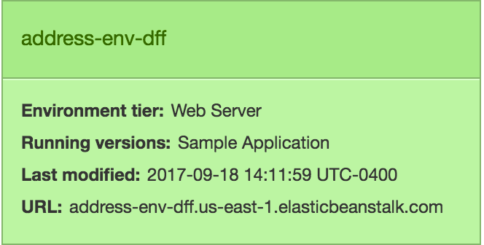
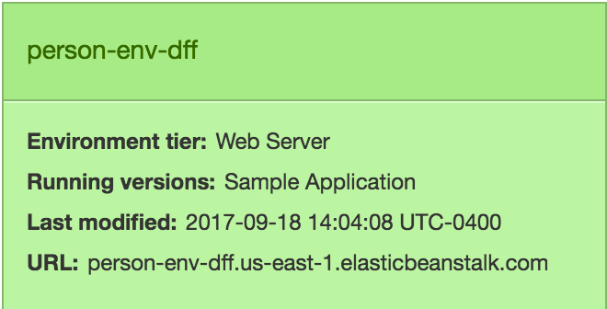
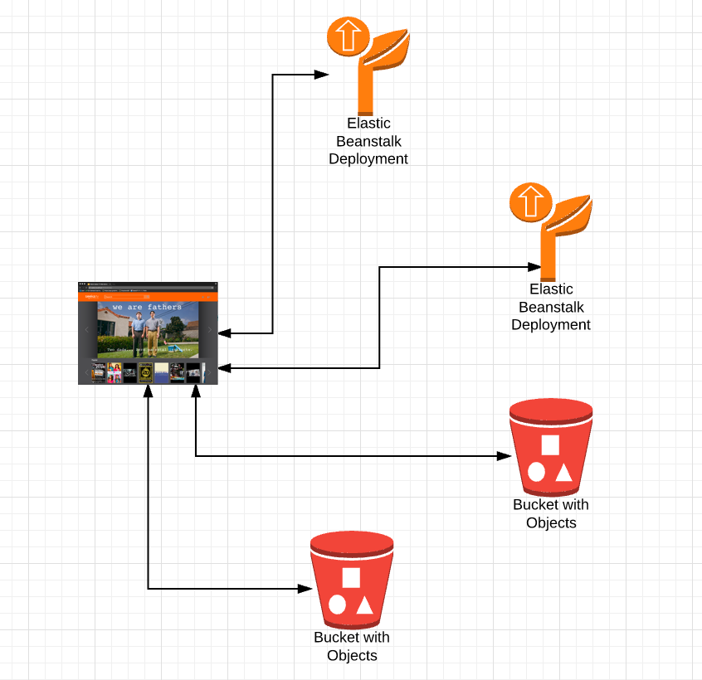
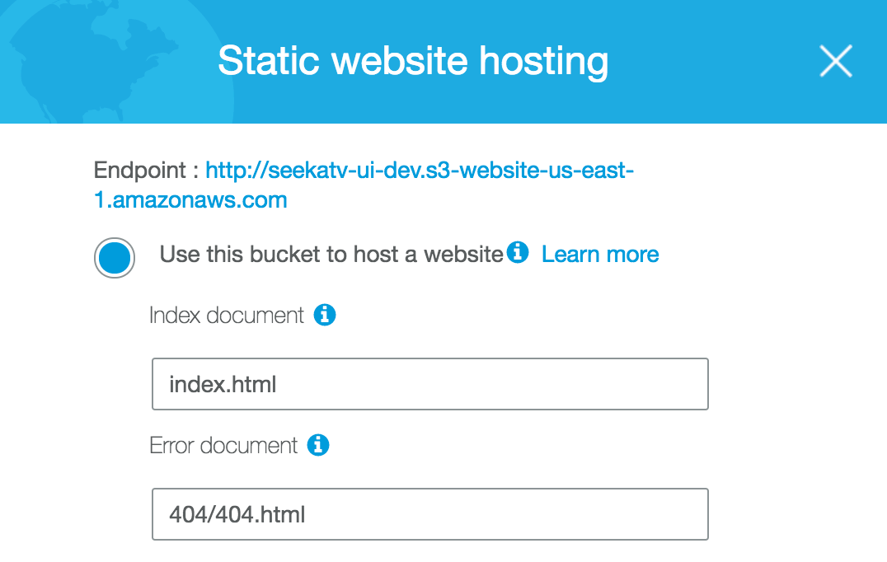
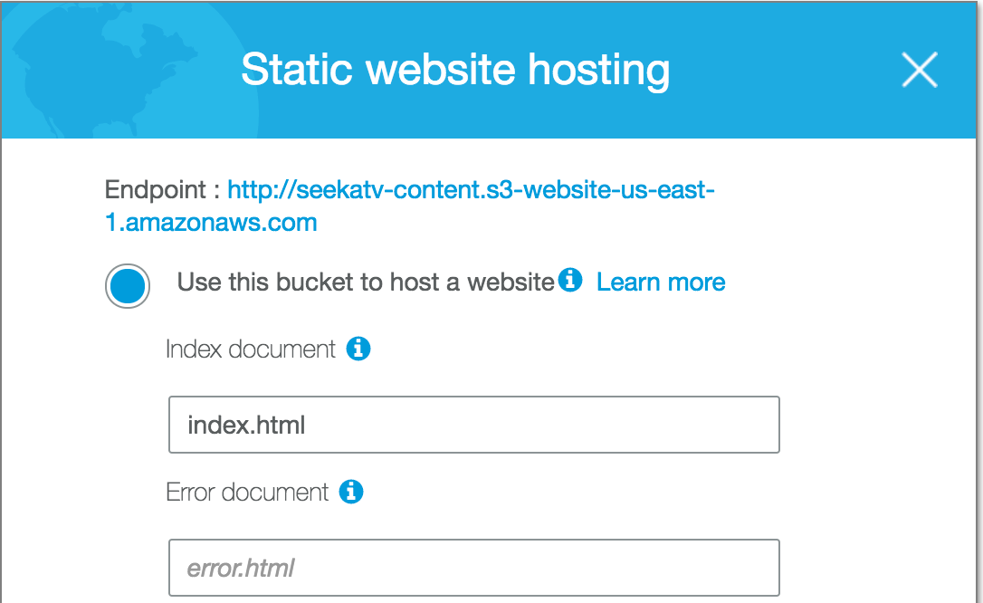
Multiple Sites

Slide 37
Multiple Sites
Four IP addresses
dff-content.s3-website-us-east-1.amazonaws.com
dff-ui.s3-website-us-east-1.amazonaws.com
address-env-dff.us-east-1.elasticbeanstalk.com
person-env-dff.us-east-1.elasticbeanstalk.com
Over two domains
And all exposed the Amazon-ness of the solution.

Slide 38
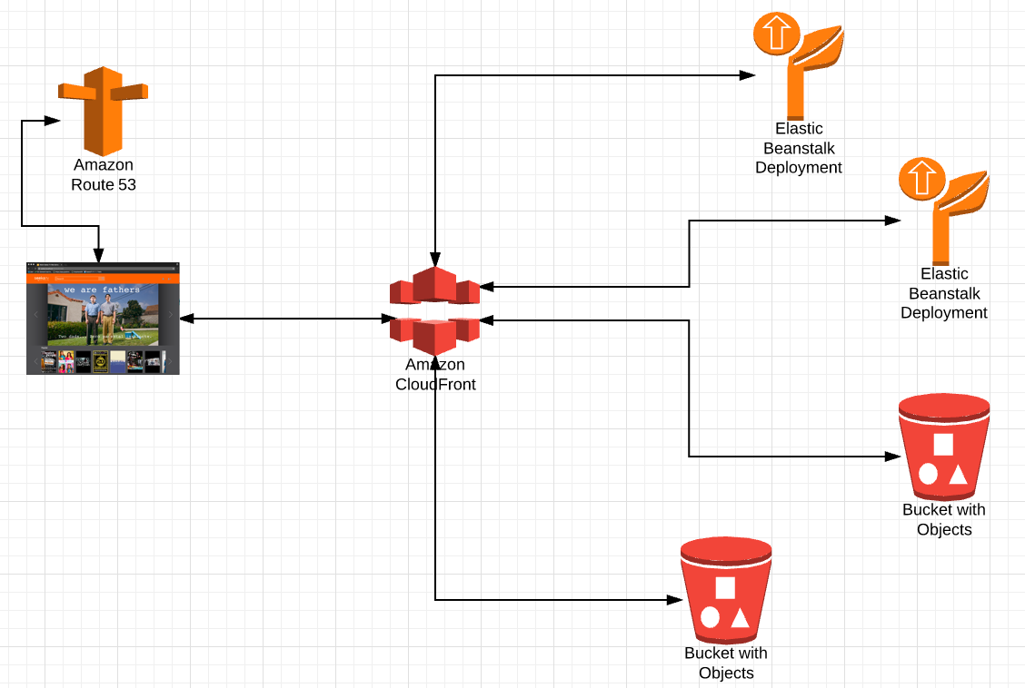
Single Site
DNS
Resolve dff-company.com to
Something.amazon.com
Under the covers
Map
/api/person
/api/address
/app
/js
/views
/app-content
/digital-assets
/images
/videos
To correct IP addresses and sub-paths

Slide 39
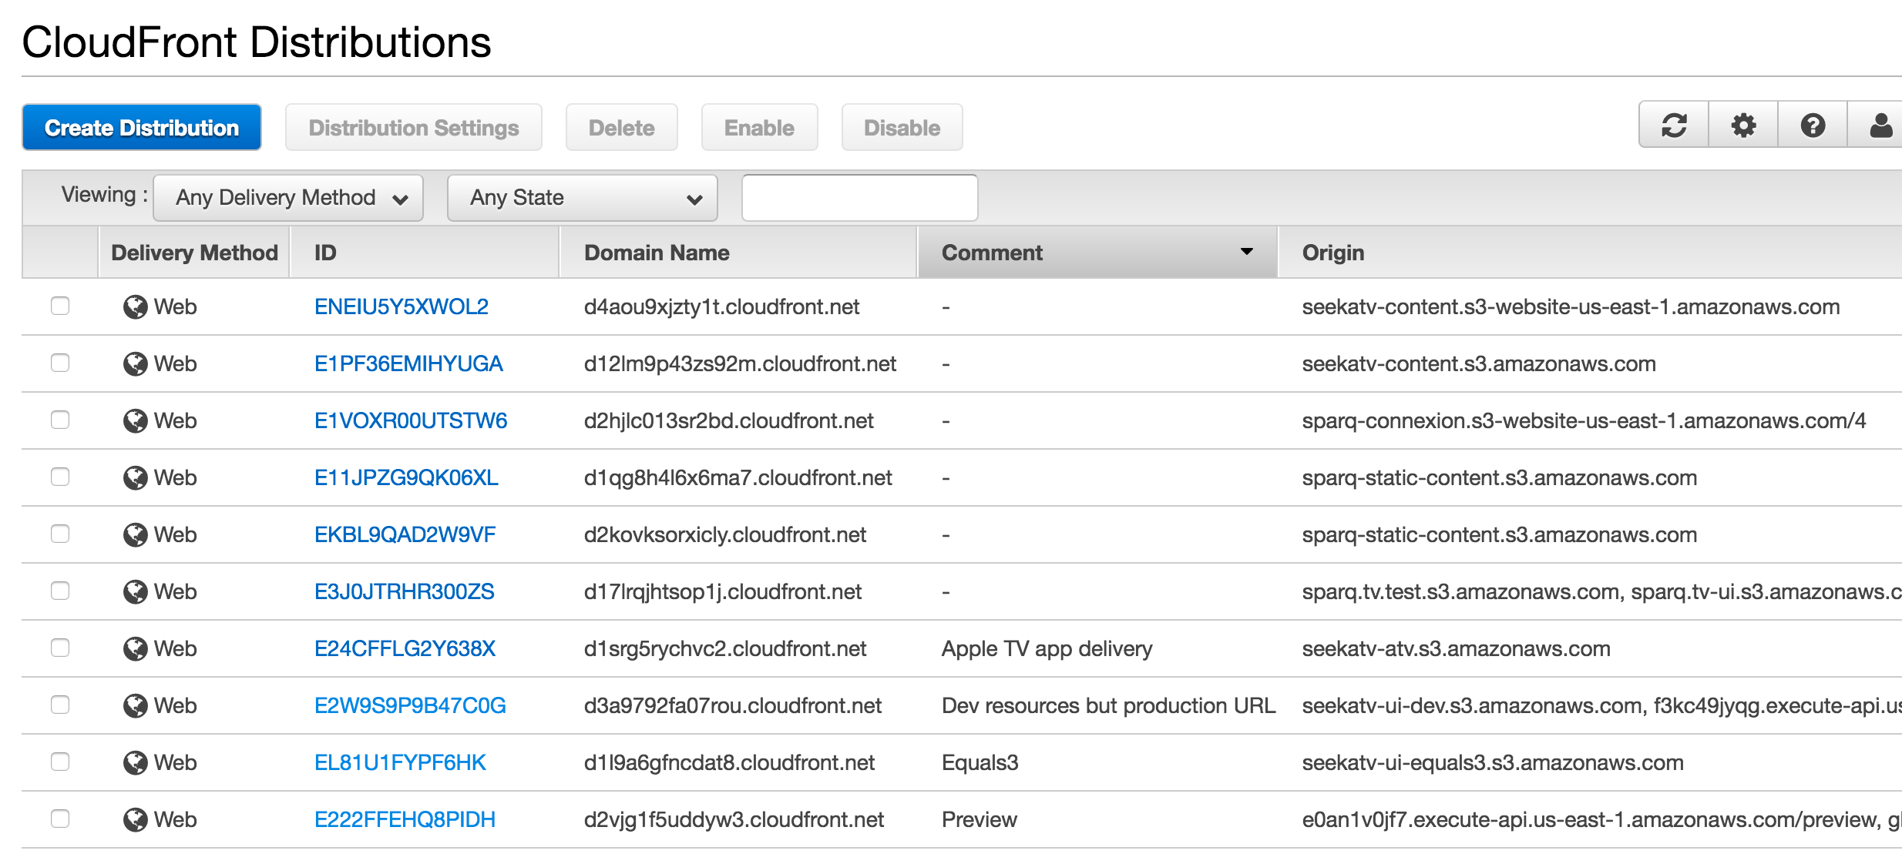
CloudFront Distributions

Slide 40
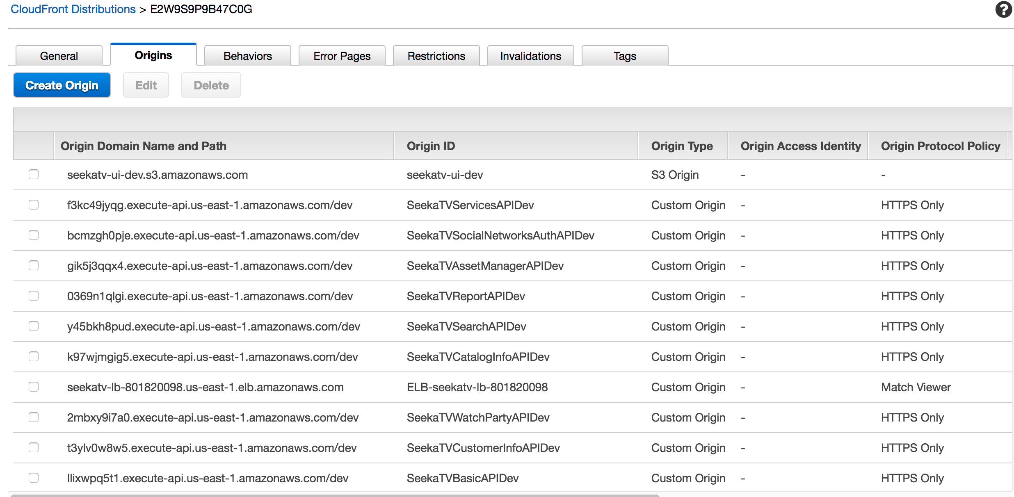
Distributions and Origins

Slide 41
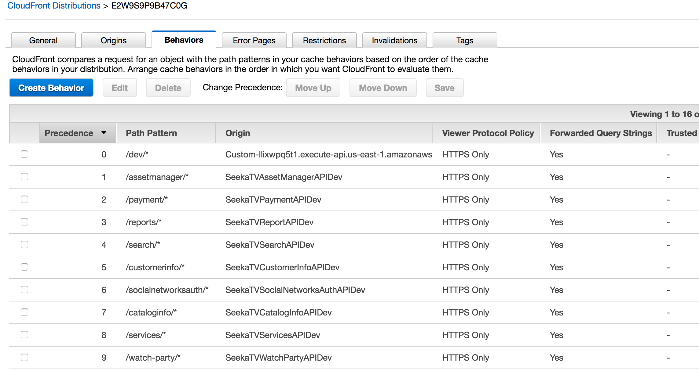
Behaviors

Slide 42
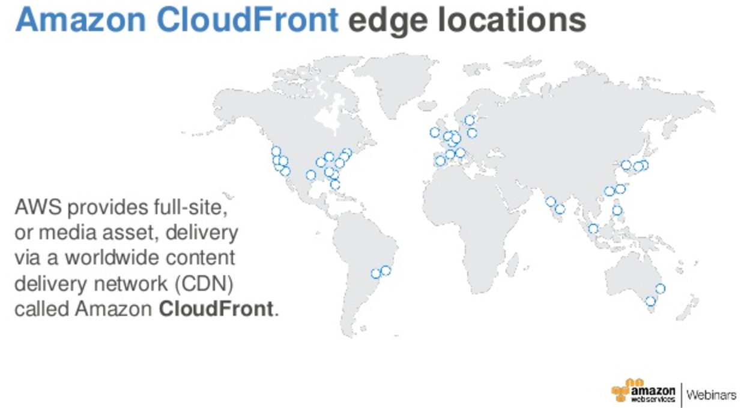
Global Caching and Optimization

Slide 43
Observations
This section has been very AWS but
The concepts apply to any non-trivial microservice/cloud application.
All enterprise deployments, large scale SaaS solutions and cloud platforms have similar concepts.
For the purposes of the next step in the project(s)
Do not worry about DNS resolution; I will setup/mockup for you.
Setup and configure CloudFront, which will be critical for
Simplified single site image.
HTTPS
We will need to consider caching configuration for responses.

Slide 44
Multitenancy Introduction

Slide 45
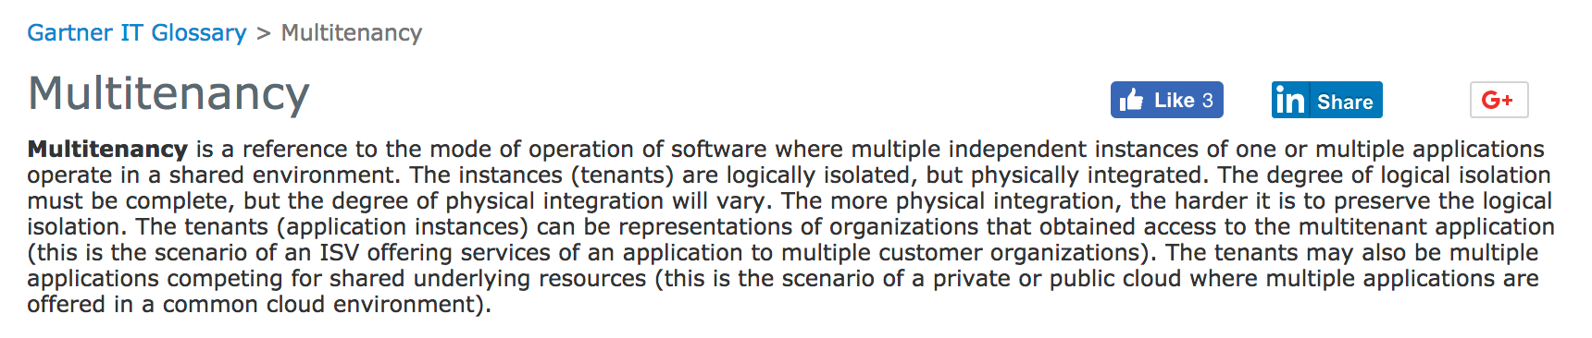
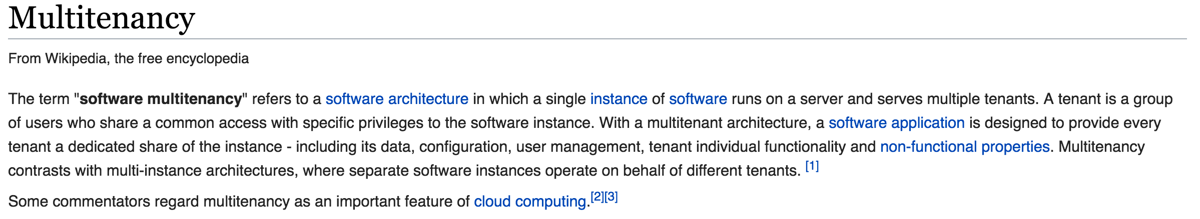
Definition
http://www.gartner.com/it-glossary/multitenancy
https://en.wikipedia.org/wiki/Multitenancy

Slide 46
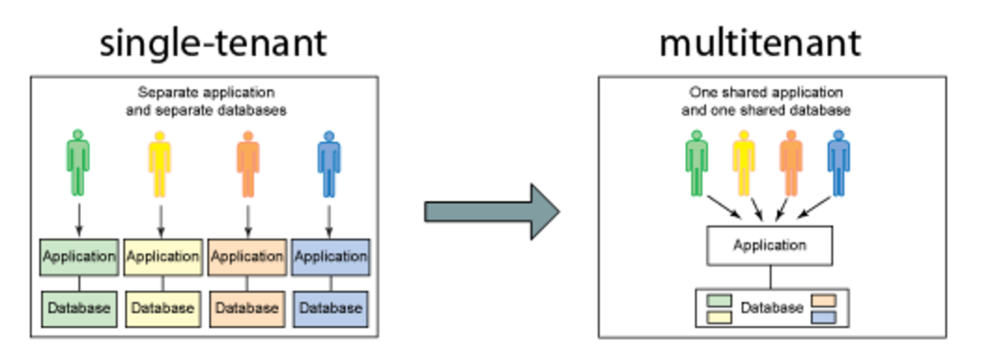
Multitenancy
http://jesusgilhernandez.com/2012/12/13/multitenancy-architecture/
Core concepts
Single codebase and “database” supports multiple customers.
Each customer (tenant) ”thinks” that have their own, dedicated instance, including customized UI, application logic and data models.
Provides significant cost and agility benefits to application provider, which also results in cost and agility benefits for customer/tenant.

Slide 47
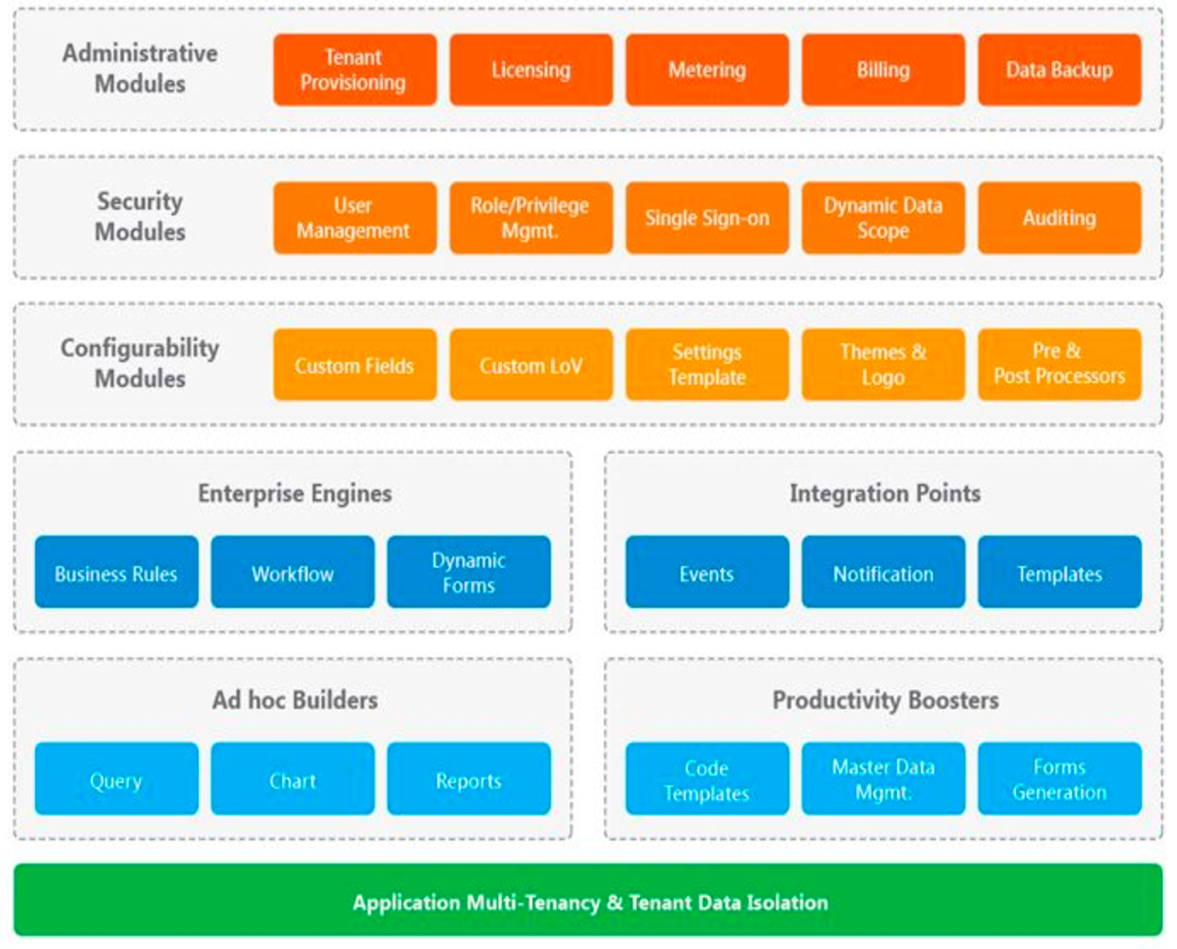
Function Areas
https://www.techcello.com/product/architecture

